Slide 1

Passerelles numériques
A Gateway for Life
Auth
Eloquent Relationships

Slide 2
Outline
Auth
1:1
1:M
M:N

Slide 3
Auth

Slide 4
Authentication
https://laravel.com/docs/5.7/authentication#authentication-quickstart
Pre-built controller for:
Register new user (create new user)
Handle authentication (login)
Forget password
Reset password

Slide 5
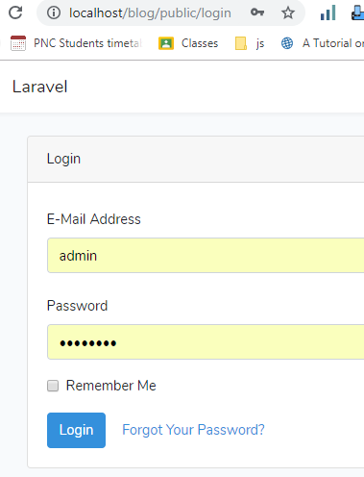
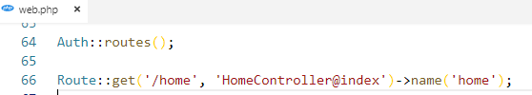
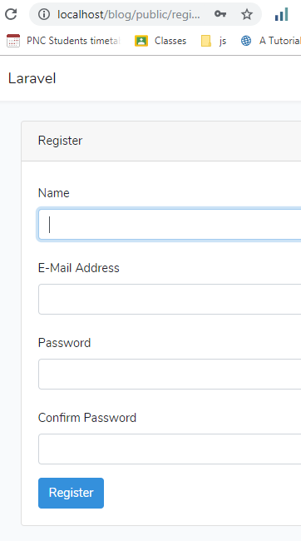
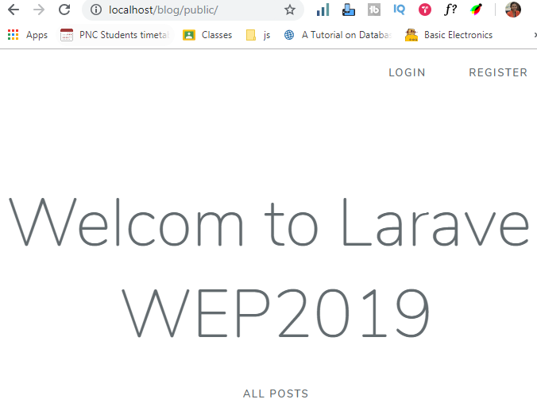
make:auth
Enable user authentication
php artisan make:auth

Slide 6
https://laravel.com/docs/5.7/migrations
https://laravel.com/docs/5.7/eloquent-relationships

Slide 7
1:1

Slide 8
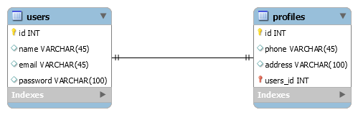
Example
User has a profile which means a profile belongs to a user

Slide 9

Create profile model and migration
Create model and migration table of Profile
php artisan make:model Profile -m

Slide 10
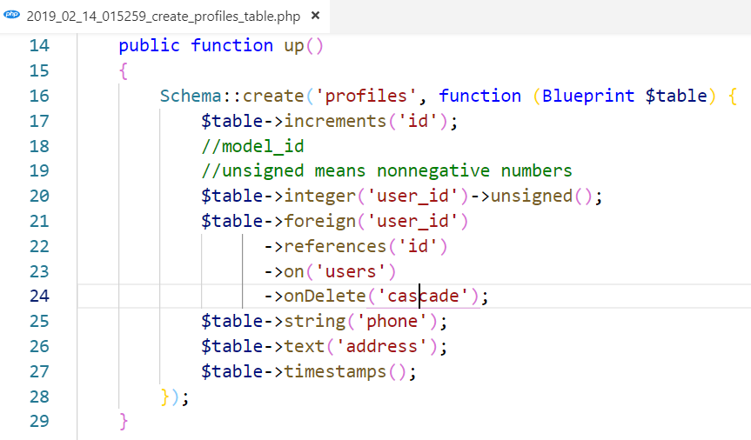
Add user id to profiles table
Add column in the profiles migration table

Slide 11

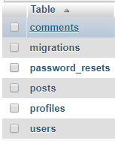
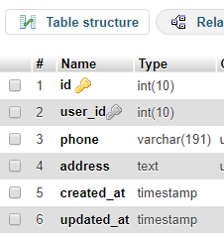
Run migrate
Run migrate to create profile table into database
php artisan migrate

Slide 12
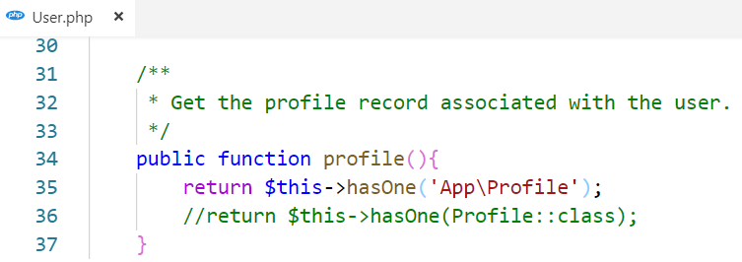
Defining relationship
A user has one profile so we place the profile method inside the user model.
The profile method should call the hasOne method and return its result

Slide 13
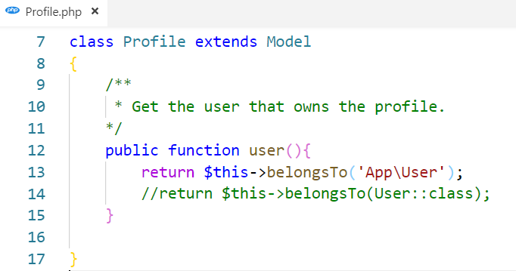
Defining relationship
A profile belongs to a user so we place the user method inside the profile model.
The user method should call the belognsTo method and return its result

Slide 14
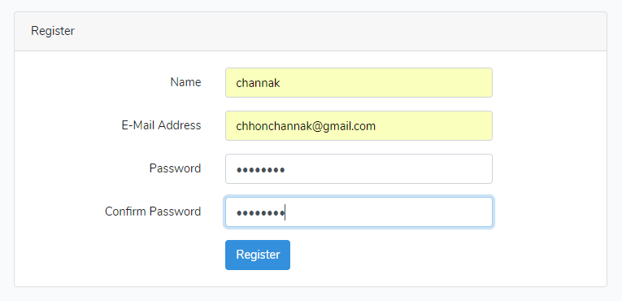

Test our method
Register or create user first

Slide 15
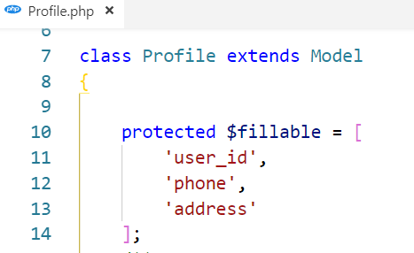
Test our method
Then create profile associate with that user.
We can insert directly vai phpmyadmin or factory and seed or using tinker
Ex: via tinker
php artisan tinker
App\Profile::create([
‘user_id’ => 1, ‘phone’ => ‘010 999 999’, ‘address’ => ‘PNC, Phnom Penh’
]);

Slide 16
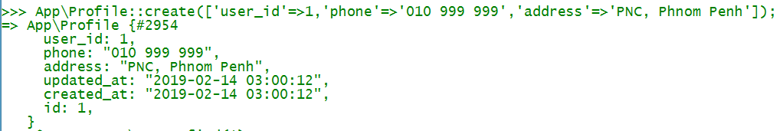
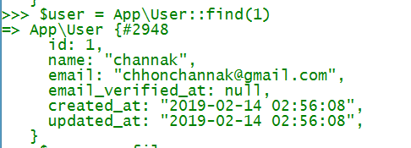
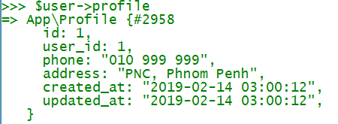
Get the profile of the specific user
Notes:
To show the profile of a user we need to find the user first

Slide 17
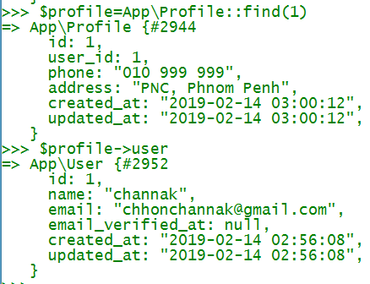
Get user whom this profile belongs to
Notes:
We can do the reverse : get profile first then find the user who this profile belongs to

Slide 18
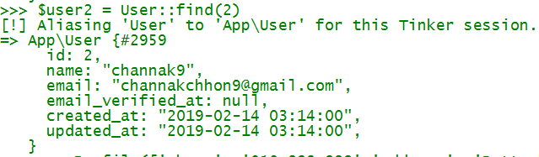
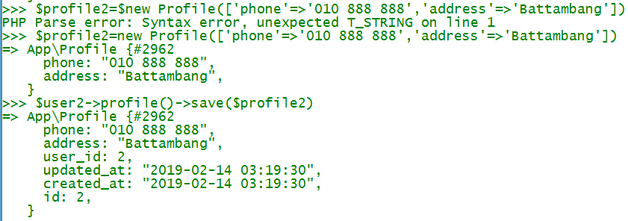
Create profile other way

Slide 19


Example
Find phone number of user with id 2
Find user name of the profile with id 1

Slide 20
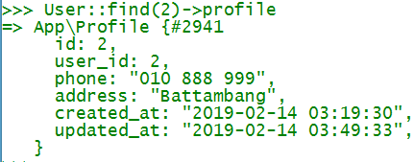
Update profile
Update phone number of user with id 2

Slide 21
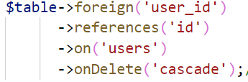

Delete profile
Delete profile of user with id 2
User::find(2)->profile()->delete()
If we delete the user, the belonging profile also deleted
Notes:
The profile of the user with id 3 also deleted from the profile table

Slide 22
Activity: 15mn
Create a user
Create a profile that associates with that user
Try to show profile of that user, edit and delete
Notes:
HW: Make the views for profile CRUD

Slide 23
1:M

Slide 24
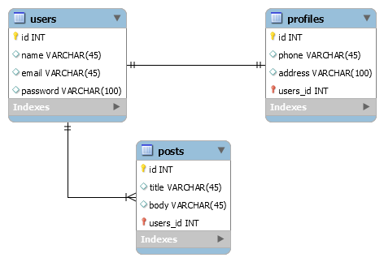
Example: User and Post
A user could have many posts and a post belongs to a user

Slide 25
Remark
We already have post, user model and table
So we need to add another column to posts in order to make relationship between post and user

Slide 26
Make add column migration
php artisan make:migration add_user_id_to_posts_table

Slide 27
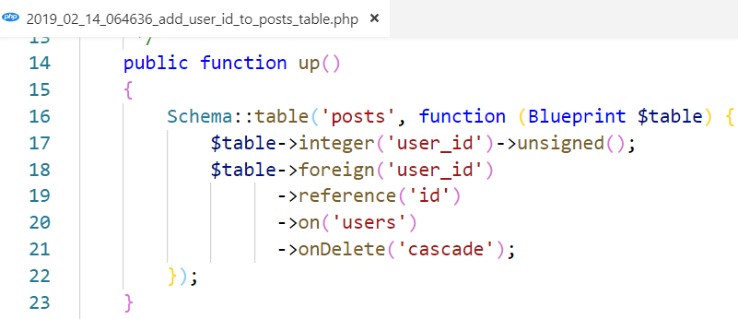
Add column and foreign key in up method
In the up() method

Slide 28
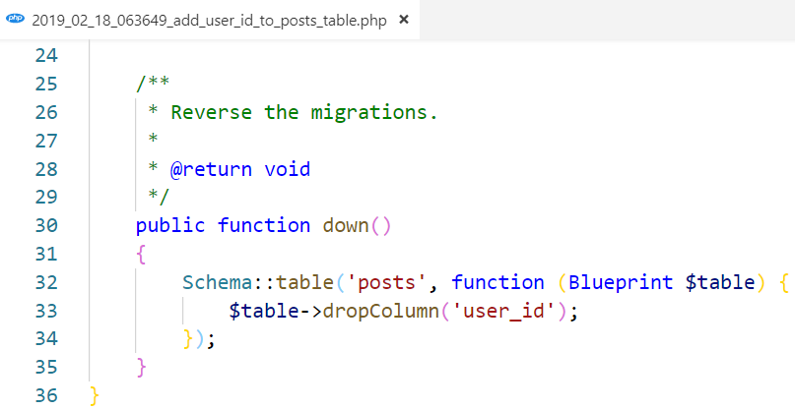
Drop column when rollback
In the down() method

Slide 29

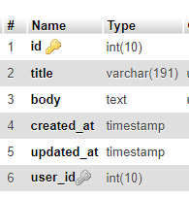
Run migration
Run migrate
Notes:
If there are exists some data already inside the post it will throw exception on fk constraint

Slide 30
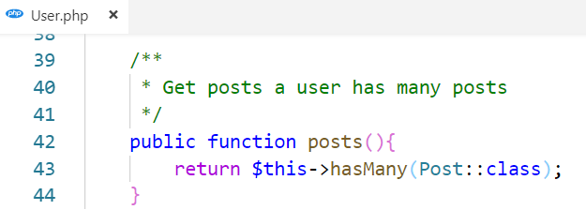
Defining relationship
A user has many posts so we place the posts method inside the user model.
The posts method should call the hasMany method and return its result

Slide 31
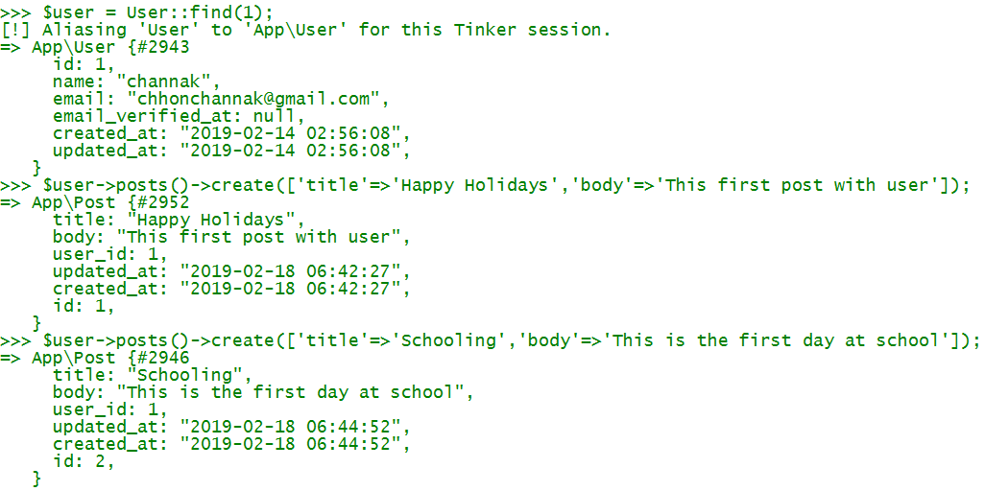
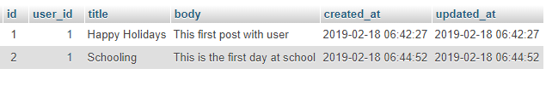
Test posts method
Notes:
//create new user with mass assignment
$user = User::create([
‘name’ => ‘dara’,
‘email’ => ‘dara@example.com’
‘password’ => bcrypt(‘password’)
]);
We can user $user = User::findorfail(1)

Slide 32
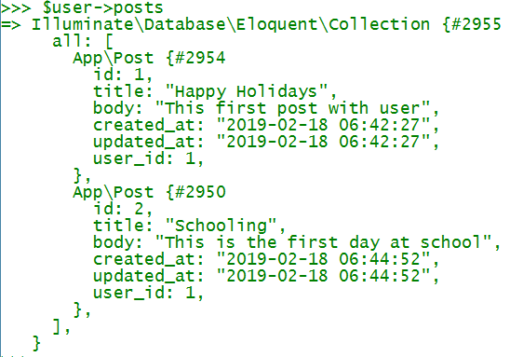
Notes:
$user->posts()->get() //it returns collection we need to use foreach to loop through collection

Slide 33
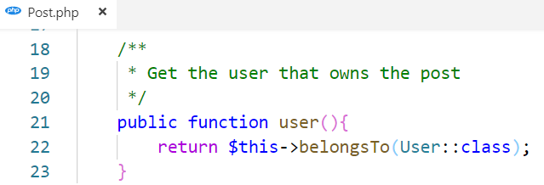
Defining relationship
A post belongs to a user so we place the user method inside the post model.
The user method should call the belongsTo method and return its result

Slide 34
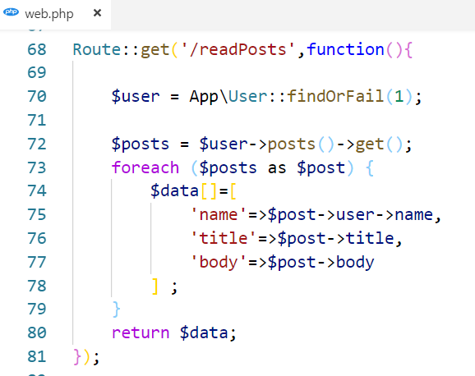
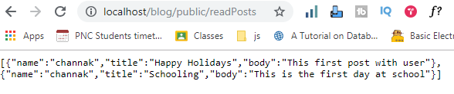
Test user method
Notes:
Route::get('/readPosts',function(){
$user = App\User::findOrFail(1);
$posts = $user->posts()->get();
foreach ($posts as $post) {
$data[]=[
'name'=>$post->user->name,
'title'=>$post->title,
'body'=>$post->body
] ;
}
return $data;
});

Slide 35
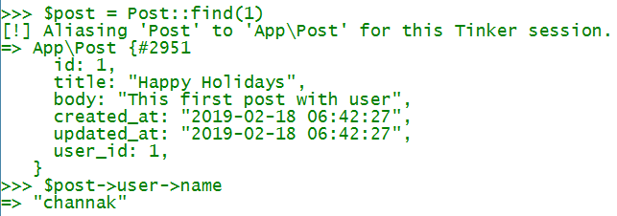

Slide 36
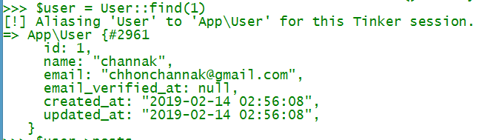
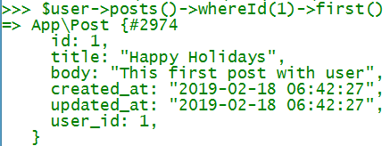
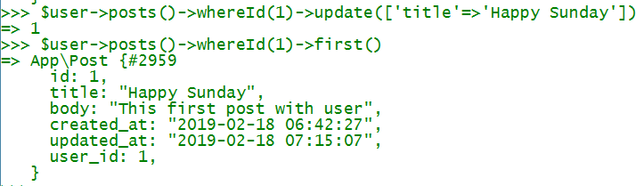
Update post
Notes:
To check out more about where
https://laravel.com/docs/5.7/eloquent
$user = User::find(1)
$user->posts()->whereTitle('Schooling')->first()
$user->posts()->whereId(1)->first()

Slide 37
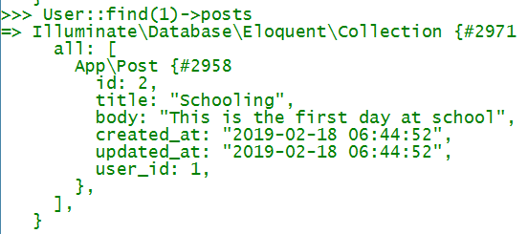
Delete the post

Slide 38
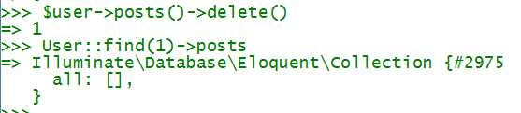
Delete all posts of user id 1
Notes:
Post::create(['user_id'=>2,'title'=>'Royal Palace','body'=>'Royal Palace is located on the...'])

Slide 39
Activity: 15mn
Create 2 posts that associate with a specific user
Then try to show all posts of that user, edit and delete any specific post

Slide 40
M:N

Slide 41
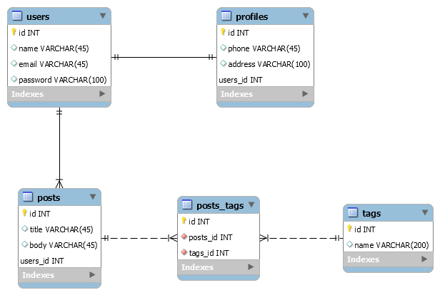
Tags and posts

Slide 42

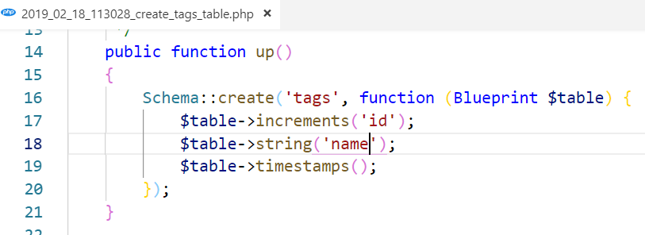
Set up tag migration
Tag migration table and model

Slide 43
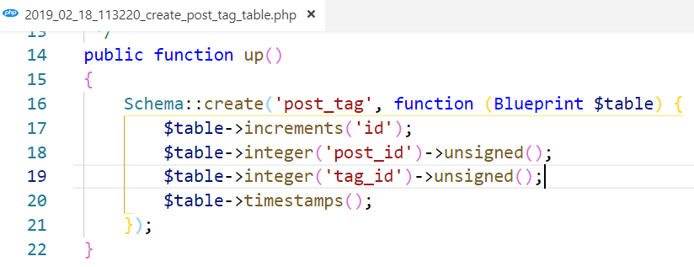
Set up post_tag migration
post_tag migration table
Notes:
This follows the alphabetical order

Slide 44
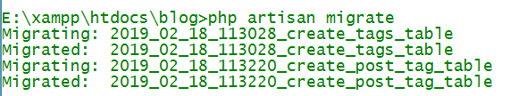
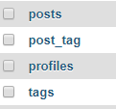
run migration
Run migrate

Slide 45
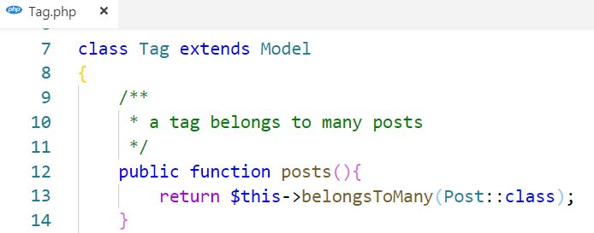
Defining relationship: Tag
A tag belongs to many posts so we place the posts method inside the tag model.
The posts method should call the belongsToMany method and return its result

Slide 46
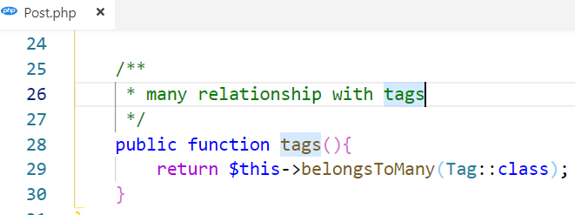
Defining relationship: Post
A post belongs to many tags so we place the tags method inside the post model.
The tags method should call the belongsToMany method and return its result

Slide 47
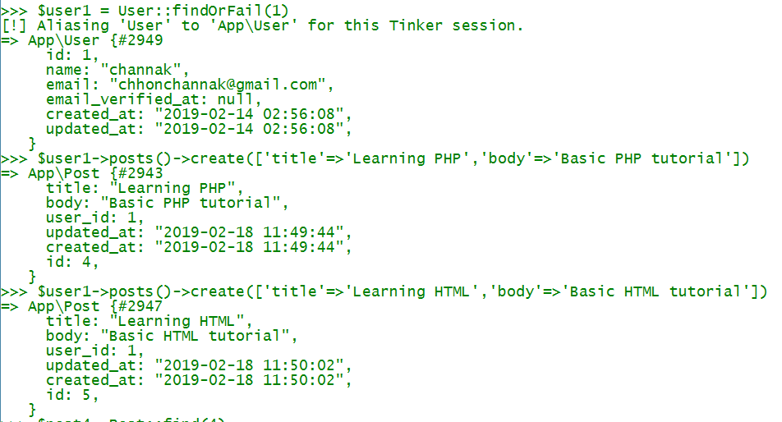
Create data
Notes:
Find user in order to create posts

Slide 48
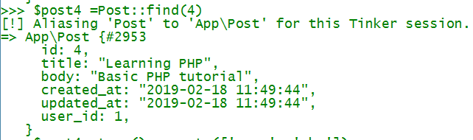
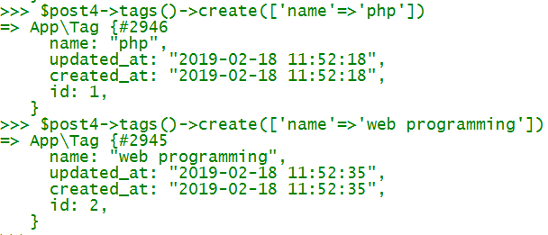
Create data
Find post then create tags by tags method

Slide 49
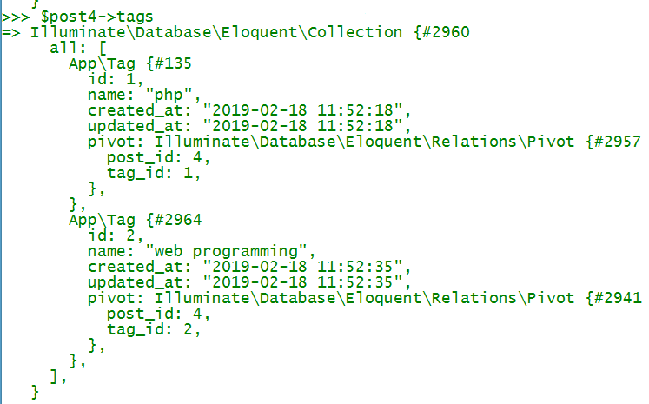

Slide 50
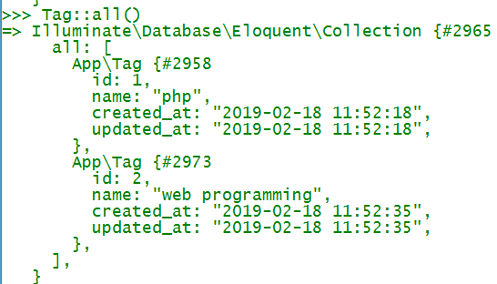

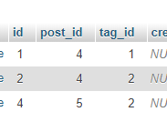

Attach tag to post
Add web programming tag to another post
Notes:
We can do multiple value in attach $post5->tags()->attach([1,2])
https://laravel.com/docs/5.7/eloquent-relationships#many-to-many-polymorphic-relations

Slide 51


Detach tag from post

Slide 52
Activity: 20mn
Create tags
Assign tags to any posts
Then try to show any post with all its associated tags, edit and delete any tags from a specific post

Slide 53

Question?
Google.com

